Slide 1
Hardware Software Platforms Project Presentation
Servomotor Control with DE1-SoC
Elora Amorison & Clelia Galvanin elora.amorison@student.umons.ac.be
Clelia.galvanin@student.umons.ac.be

Slide 2
Contents
Context and Objectives
Software and Hardware installation
Software to install
Board installation
Tests with the board and LabView
Creating a new project
Servo-motor
Board Control
Simulations
Results
Software operation

Slide 3
Contents
Context and Objectives
Software and Hardware installation
Software to install
Board installation
Tests with the board and LabView
Creating a new project
Servo-motor
Board Control
Simulations
Results
Software operation

Slide 4
Context and Objectives
This project is part of the course Hardware/Software Platforms for students in first master in Electrical Engineering at the Faculty of Engineering of Mons
Objectives:
To handle an entire electronical project
To familiar us with processors De-SoC
To control a Servomotor
To understand the VHDL coding language
To create a tutorial for other users

Slide 5
Contents
Context and Objectives
Software and Hardware installation
Software to install
Board installation
Tests with the board and LabView
Creating a new project
Servo-motor
Board Control
Simulations
Results
Software operation

Slide 6
Software to install
Quartus II
http://fpgasoftware.intel.com/?edition=lite
To install the software, you’ll need both the Quartus software tarfile, and the CycloneV qdz file.
Save these both to the same directory.
ModelSim
Select also the “ModelSim-Altera Starter Edition”.
ModelSim is a HDL Simulator and will be used to simulate signals before using the board.

Slide 7
Hardware to install
DE1-SoC
https://www.terasic.com.tw/cgi-bin/page/archive.pl?Language=English&No=836
In the package, you can find the cable to supply the FPGA and an other one to connect to the computer

Slide 8
Contents
Context and Objectives
Software and Hardware installation
Software to install
Board installation
Tests with the board and LabView
Creating a new project
Servo-motor
Board Control
Simulations
Results
Software operation

Slide 9
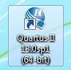
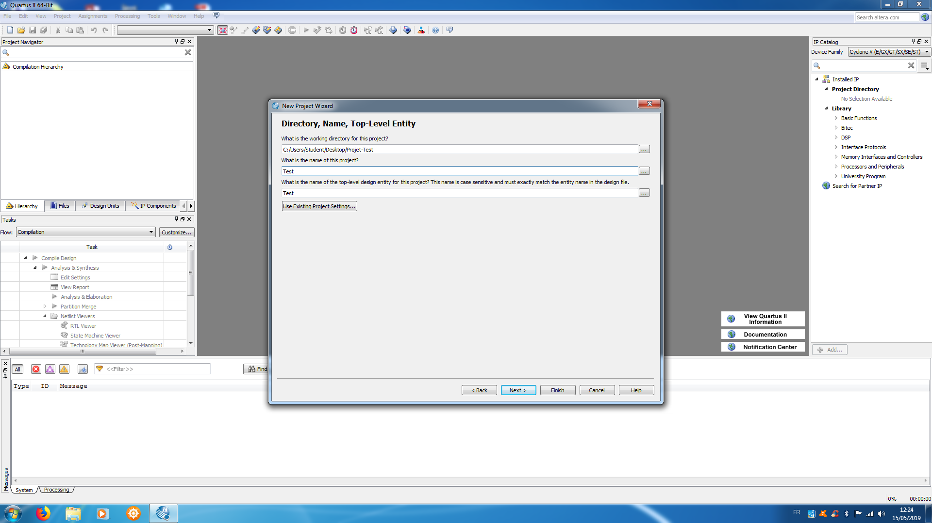
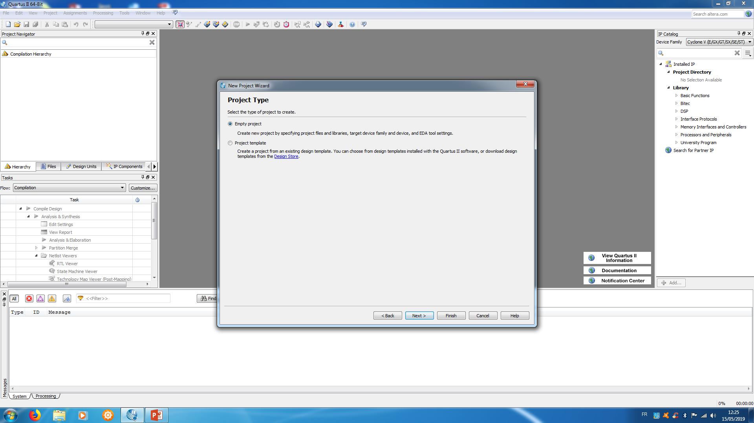
Create a new project on Quartus
Open Quartus II
Click on “Create a new project”
A new window will open
Select the folder and the title of your project
Next
Click on “empty project”

Slide 10
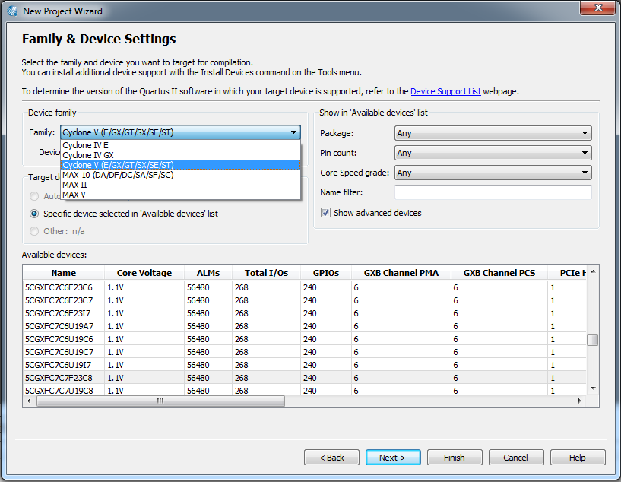
Create a new project on Quartus
A window “Family & Device Settings” will open
Select the right family of your component and then “next”
Here, it is a Cyclone V
5CSEMA5F31C6N

Slide 11
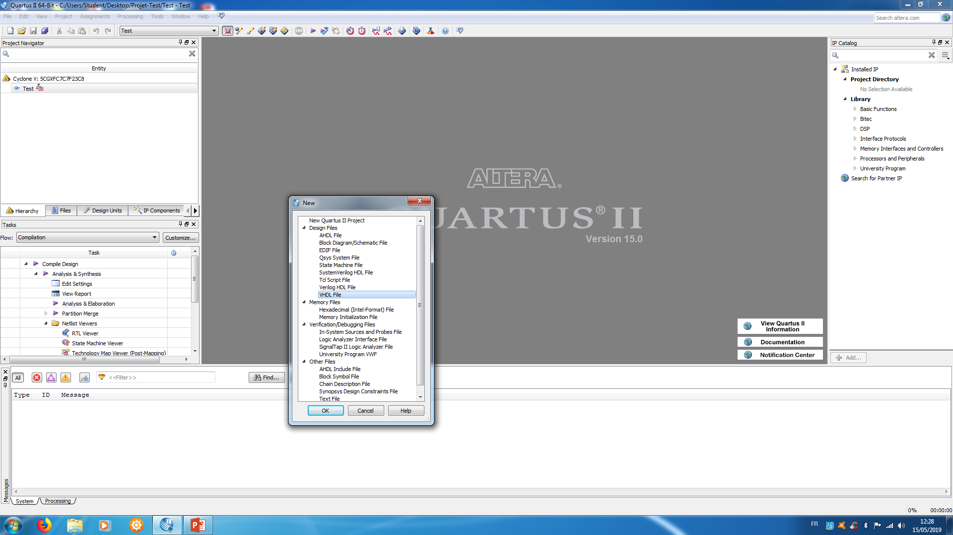
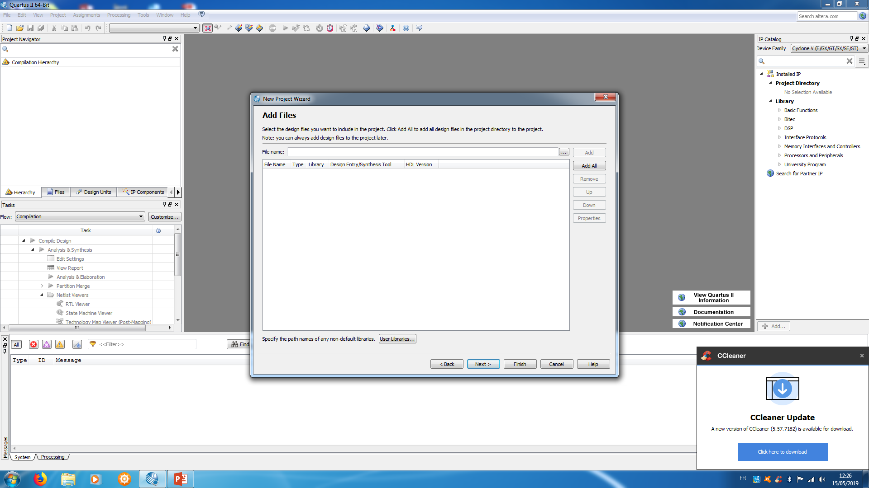
Create a new project on Quartus
Create new file
Create a new file at your project and select the VHDL Type File
You can also add an existing file at your project

Slide 12
Contents
Context and Objectives
Software and Hardware installation
Software to install
Board installation
Tests with the board and LabView
Creating a new project
Servo-motor
Board Control
Simulations
Results
Software operation

Slide 13
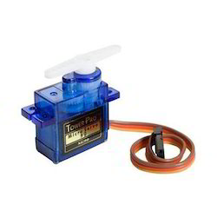
Servomotor
What is a servomotor ?
Electrical device, that rotate a part of its body
with high efficiency and great precision to a
particular angle between 0 and 180°)
How to connect a servomotor?
Three cables
The yellow wire connected to the pin of the board: GPIO1(1)
The red wire connected to 5V on the board GPIO1(10)
The brown (or black) wire connected to the ground on the board GPIO1(11)

Slide 14
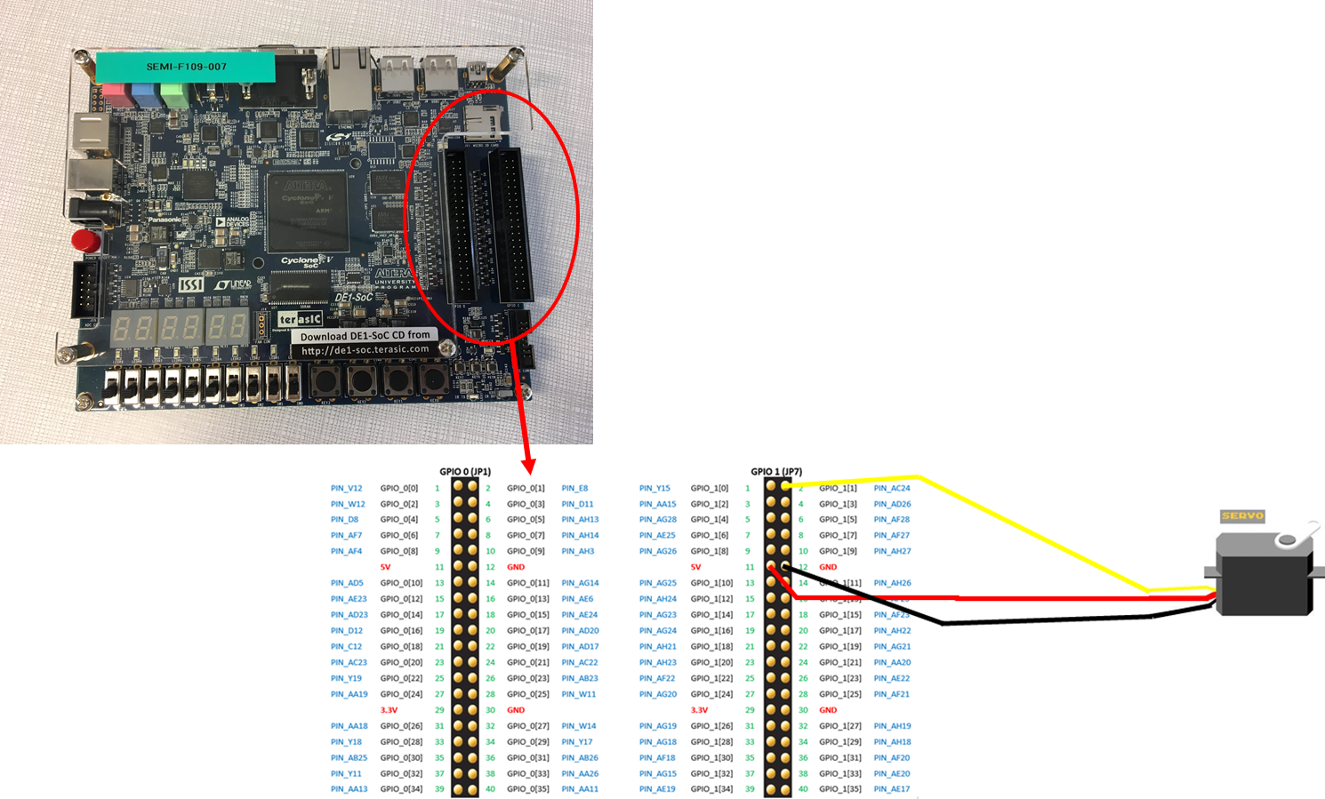
Servomotor

Slide 15
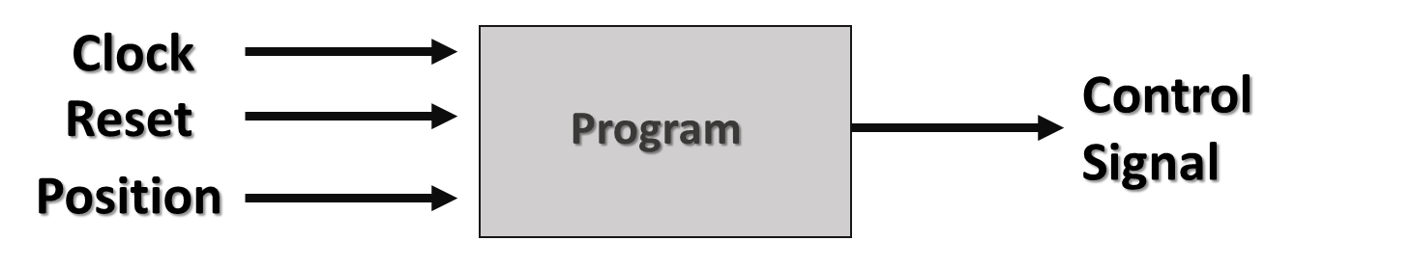
Bloc Diagram to Control a Servomotor
The values of the position came from the Switch of the board
The control signal goes to the GPIO1(1) pin and then directly to the servomotor

Slide 16
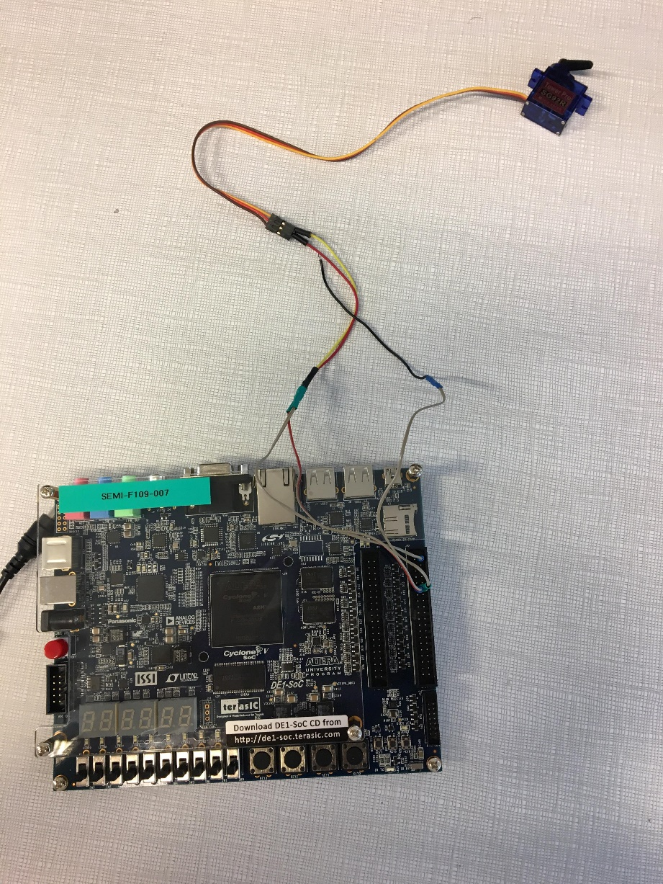
Connection between the board and the motor

Slide 17
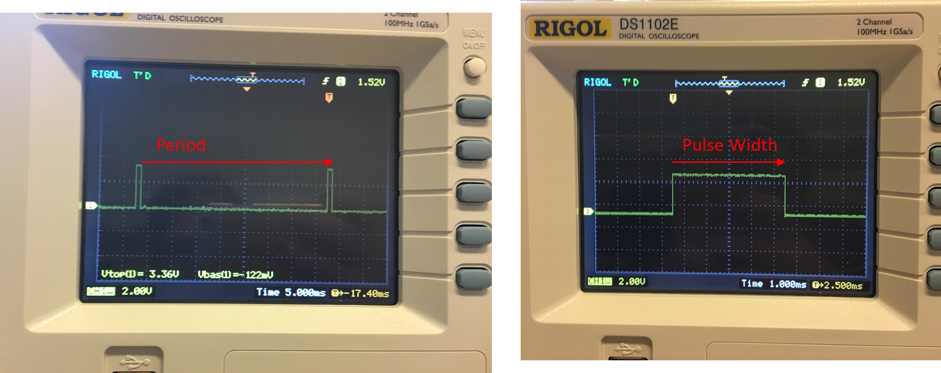
Servomotor
How it works?
Coding a square wave of different pulse width
Period of 20 ms
Minimal value of 0,5ms and maximal value 2,5ms

Slide 18
Contents
Context and Objectives
Software and Hardware installation
Software to install
Board installation
Tests with the board and LabView
Creating a new project
Servo-motor
Board Control
Simulations
Results
Software operation

Slide 19
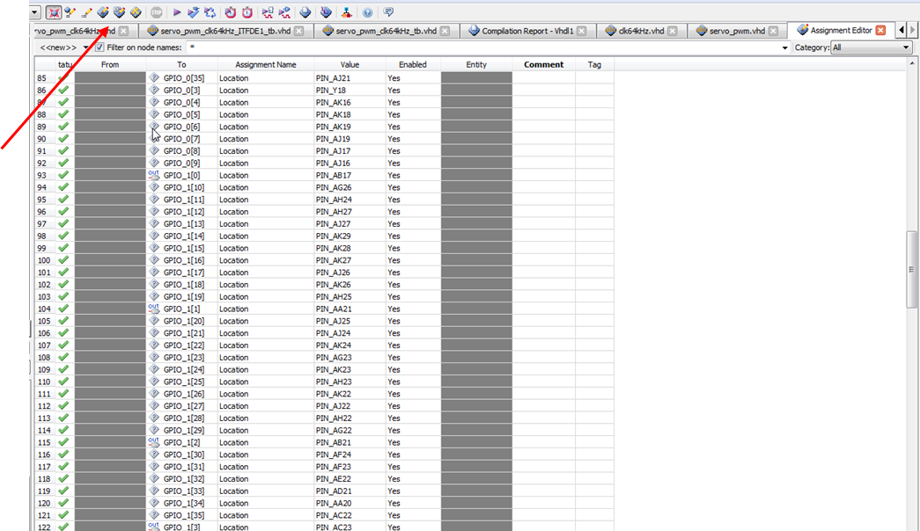
Board Control
How to link the hardware and the software?
Connect the board to the computer
Create a file to connect the signals with the pins of the board
To have a look
at all the pins
of your board
you can click on
this icone

Slide 20
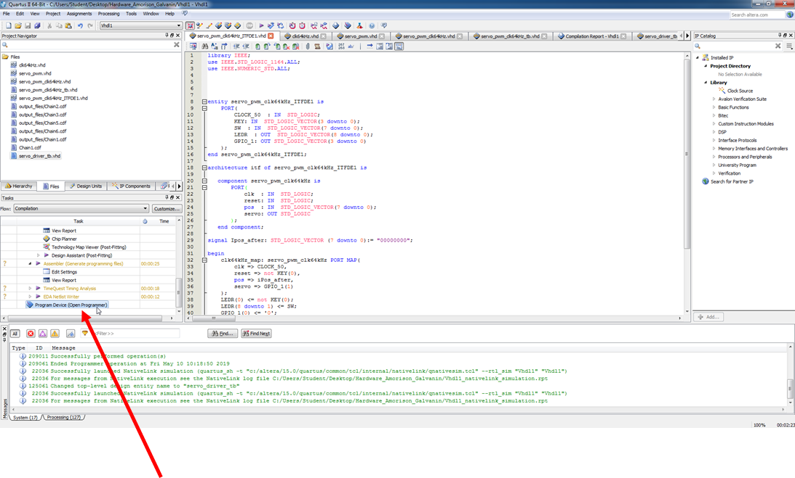
Board Control
How to put the code on the processor?
Click on the Program Device

Slide 21
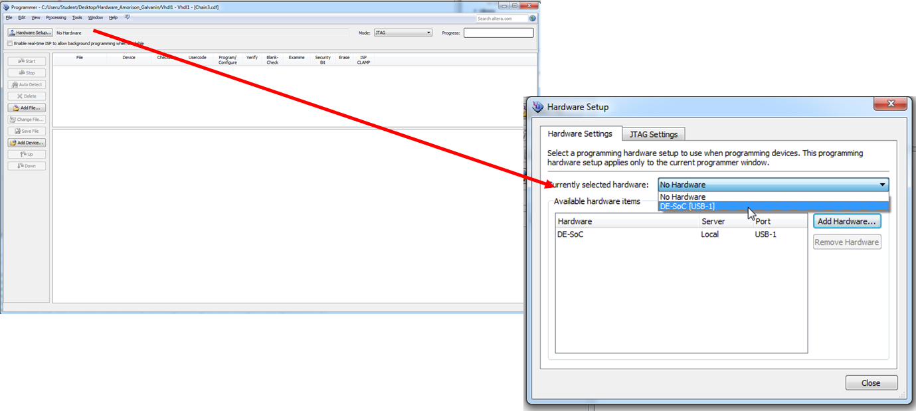
Board Control
How to put the code on the processor?
A window will open
Click on “Hardware Setup” and choose your harware

Slide 22
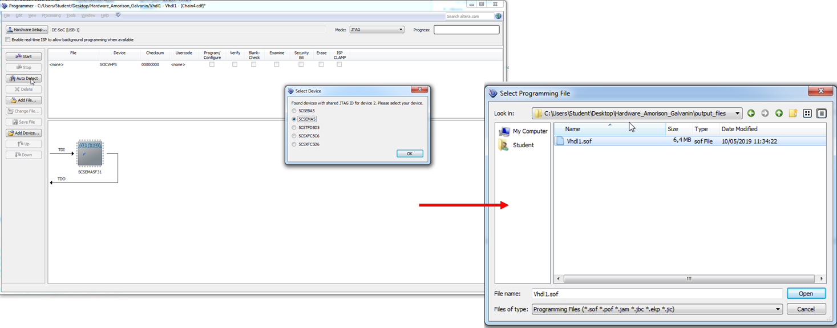
Board Control
How to put the code on the processor?
Click on “Auto Detect” and choose your correct device
Then on “Add File” and select your own file
Finally, click on “Start” and wait for the loading of your code

Slide 23
Contents
Context and Objectives
Software and Hardware installation
Software to install
Board installation
Tests with the board and LabView
Creating a new project
Servo-motor
Board Control
Simulations
Results
Software operation

Slide 24
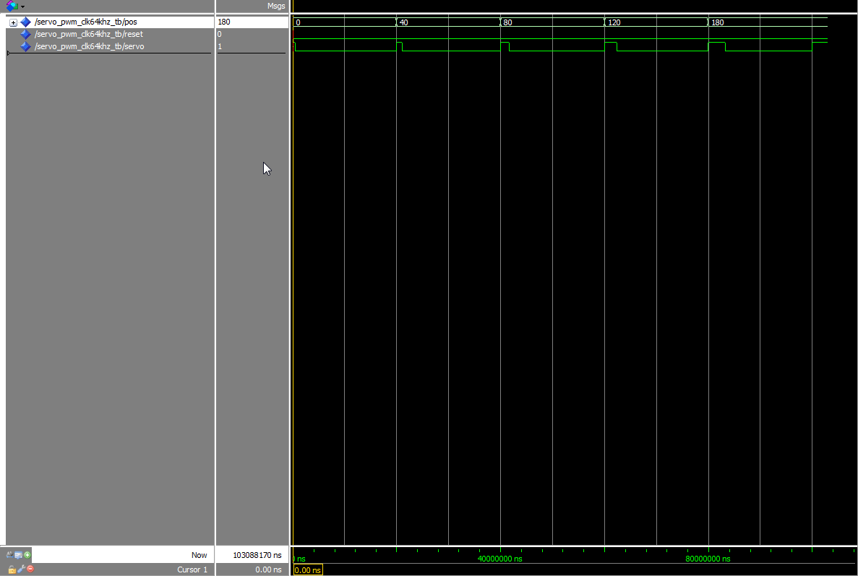
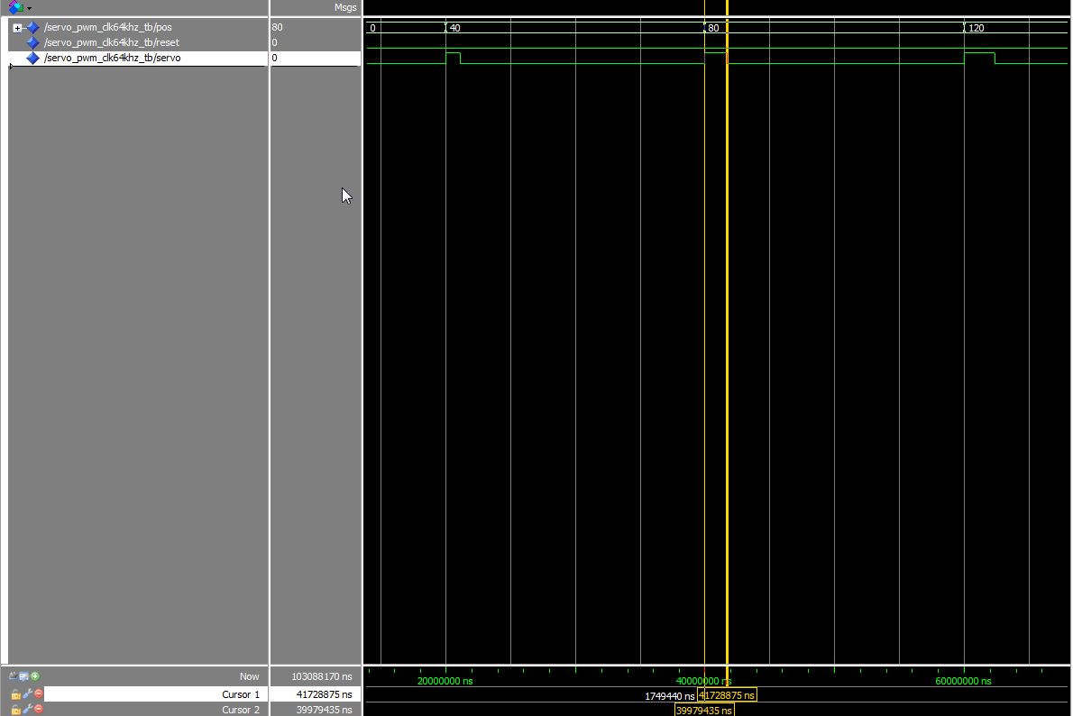
Simulations
Driver Simulation
For the simulation, we define some values for the variable « pos ».
We can see the control signal becoming bigger and bigger.
We can zoom to see the value of PWM and so, the PWM value for an 80° angle is 1749440 ns.

Slide 25
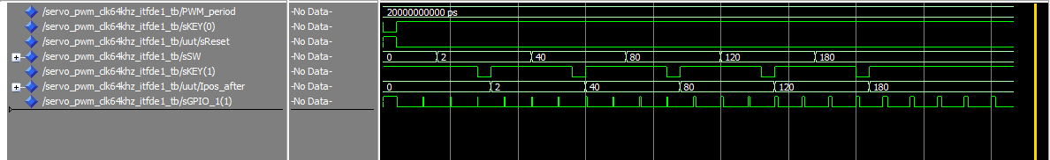
Simulations
Driver+Application Simulation
We change the values of switchs and therefore pos after 3 PWM half period = 3*10ms
We wait for 3 additional PWM half period before pressing the button.
We wait for 1 additional PWM half period before releasing the button.
When the button is released -> switchs values go to Ipos_after.
PWM value is then modified from the next impulse.
We notice that the PWM value increases according to the angle.

Slide 26
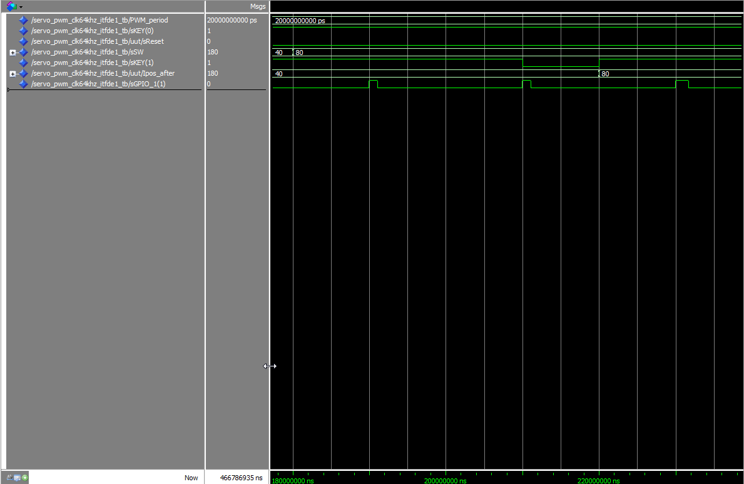
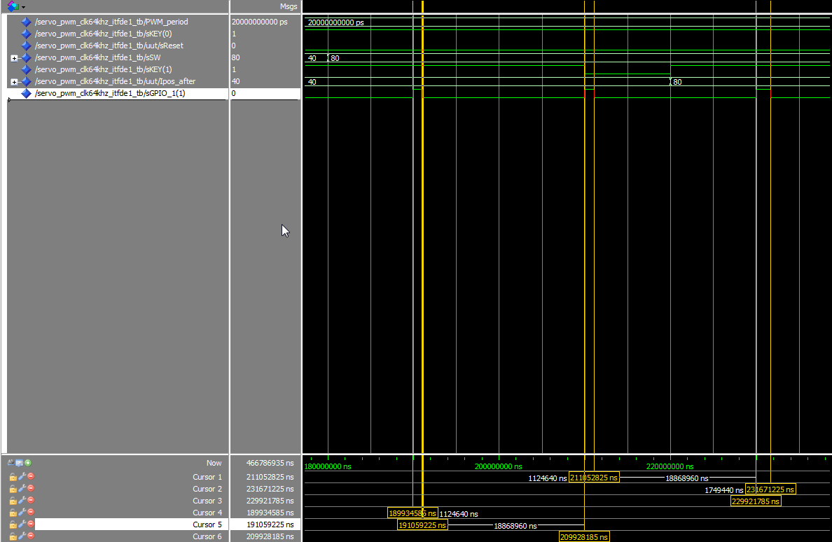
Simulations
Driver+Application Simulation
We make a zoom to measure PWM values and check that the values are growing
proportionnaly with the angle.
Wa can see that the PWM value for an 40° angle is 1 124 640ns and for an 80° angle
is 1 749 440ns (which is equal to our previous value.)

Slide 27
Contents
Context and Objectives
Software and Hardware installation
Software to install
Board installation
Tests with the board and LabView
Creating a new project
Servo-motor
Board Control
Simulations
Results
Software operation

Slide 28
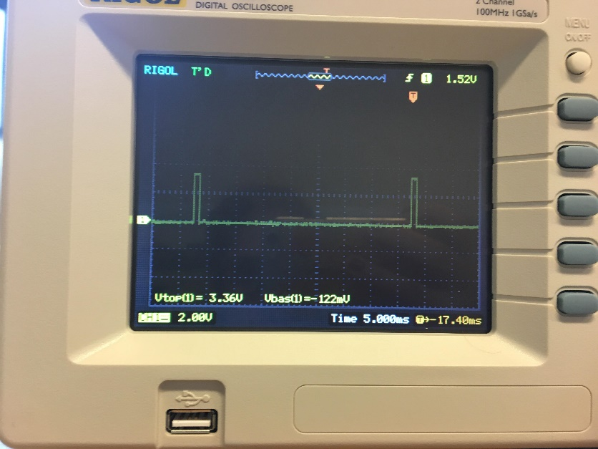
Results
Results on an oscillator
Results on the servomotor
See the video

Slide 29
Contents
Context and Objectives
Software and Hardware installation
Software to install
Board installation
Tests with the board and LabView
Creating a new project
Servo-motor
Board Control
Simulations
Results
Software operation

Slide 30
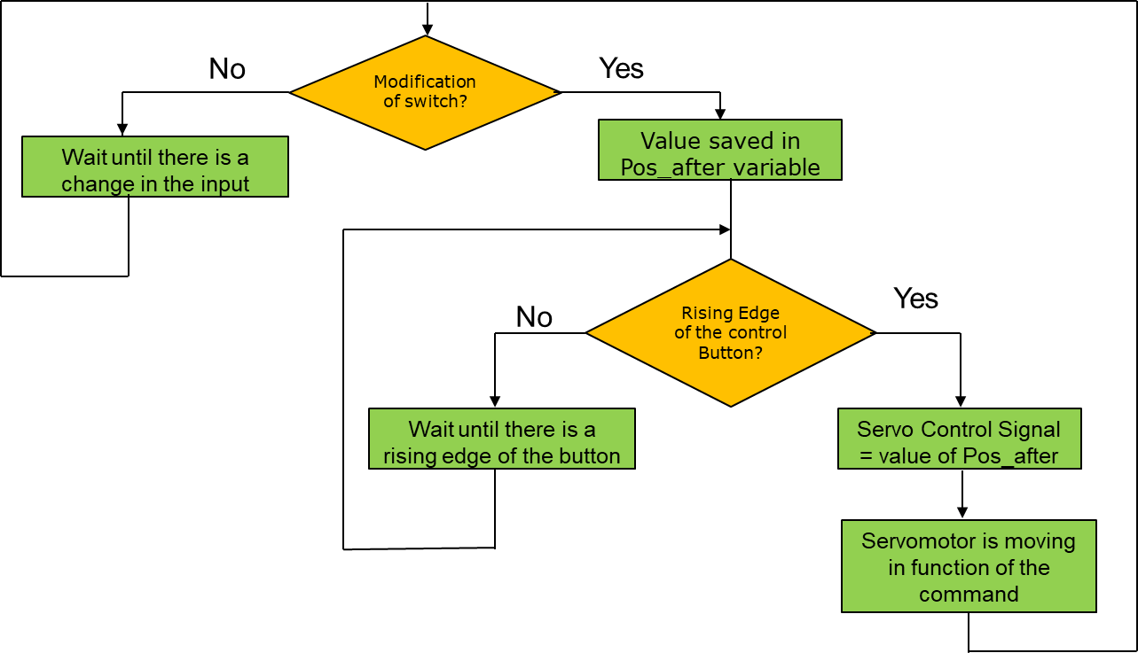
Software Operation
Diagram block of the behaviour of our program

Slide 31

Conclusion
Congrats !
You can now drive a servo-motor with a new processor!

Slide 32
Useful links
Github:
https://github.com/cleliagal/Control-of-Servo-motor-with-DE1-SoC
Youtube Video:
https://www.youtube.com/watch?v=HVyE35rkSaQ

